Slide 1
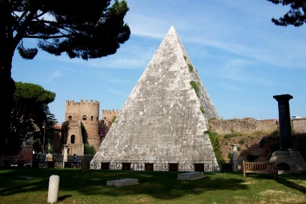
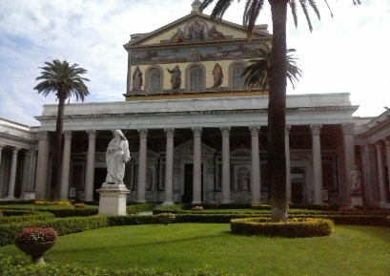
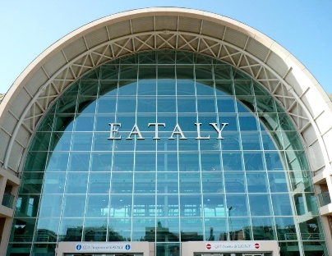
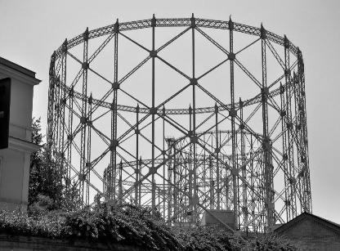
Dates: Feb 28-29, March 1, 2024
Venue: Abitart Hotel (https://www.abitarthotel.com/en/)
Address: Via Pellegrino Matteucci, 10, Rome, Italy
https://www.abitarthotel.com/en/how-to-reach-us
Piramide Cestia
International airports
Leonardo Da Vinci, Fiumicino (FCO) www.adr.it/web/aeroporti-di-roma-en
G. B. Pastine, Ciampino (CIA) www.ciampino-airport.info/
Basilica San Paolo
Closest train station: Ostiense station (mainly short distance trains)
Main train station: Termini station (mainly long distance trains)
Closest Metro Stop: Piramide (Metro B Line)
Bus lines (ATAC): 23, 30, 715, 716, 280
Gazometro
Taxi stand Piramide

Slide 2
Ways to get to the meeting venue from Fiumicino
Fiumicino (FCO)
Option 1
Option 2
Option 3
Taxi fare 48+ €
Airport Train Station
Airport Bus Station
Airport Train Station
Airport Shuttle
T.A.M.
Terravision
Metropolitan train FM1 to Fara Sabina
Leonardo Express to Termini
Metro B line (towards LAURENTINA)
Get-off at
Ostiense train station
Walk the tunnel link to EATALY
Get-off at
Ostiense (EATALY)
Get-off at
Piramide/Ostiense stop

Slide 3
Ways to get to the meeting venue from Ciampino
Airport Train Station
Ciampino (CIA)
Airport Shuttle
TERMINI TRAIN STATION
Metro B line (towards LAURENTINA)
Get-off at
Piramide/Ostiense stop
Taxi fare 30-40 €

Slide 4
Check hotels along the metro B line (some suggestions)
Direction
IONIO/TIBURTINA
Metro B Line (Blue Line)
Direction
LAURENTINA
Closest Metro Stop: Piramide
Circo Massimo
Garbatella
Colosseo
San Paolo
Abitart Hotel (meeting venue)
Gasometer Urban Suites
PEPOLI9 DESIGN SUITES
B&B Colori di Roma
Domus Giordano
B&B Easy
Althea Inn Roof Terrace
City Lights Rome
Crossroad Hotel
Cavour
Marconi
Magliana
Termini
EUR Palasport
Castro Pretorio
EUR Fermi
Capo D'Africa Hotel – Colosseo
Hilton Rome Eur La Lama
Grand Hotel Palatino
Via Cavour
Viale G. Marconi 905
Parking at Abitart Hotel
24 h fare: 24,00 EUR
Meeting fare 8:00-18:00: 13,00 EUR
By hour: 2,50 EUR
Via Amedeo Avogadro, 35
00146-Quartiere Marconi

