Slide 1
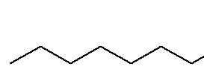
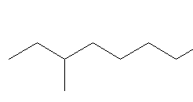
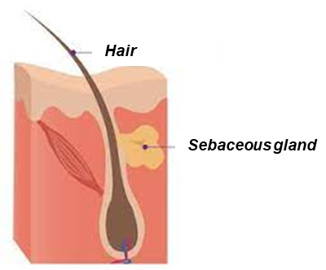
CA21108_WG5_Expert_Series_Webinar
June 16th, 11 AM (CET)
15 min + discussion
Sebum
Title: Sebaceous gland lipids
Sebaceous glands produce and secrete sebum, a mixture of multiple lipid structures. Sebum lubricates skin and contributes to the epidermal barrier function by minimizing water loss. Sebum is a nutrient for the skin microbiome and acts as a shield against pathogens, due to its antimicrobial properties. Sebum also participates to the prevention of UV-induced damage. This second part of the webinar will introduce the fundamental aspects of the sebaceous gland secretion.
Speaker: Emanuela Camera
San Gallicano Dermatological Institute – IRCCS, Rome, Italy
About the speaker:
Emanuela Camera is a pharmaceutical chemist with a specialization in Clinical Pathology. She heads the Integrated Centre for Metabolomics Research within the Laboratory of Cutaneous Physiopathology at the San Gallicano Dermatological Institute, IRCCS. She is passionate about lipids. Her research focuses on the constitutive composition and (oxidative) changes of skin surface lipids, including sebum, in humans and mouse models of inflammatory skin diseases. Cellular responses to lipotoxic and inflammatory cues, dysregulated lipid-processing pathways, lipid oxidation, and antioxidant response, contribute to her lines of research.

