Slide 1
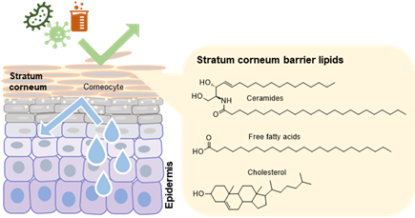
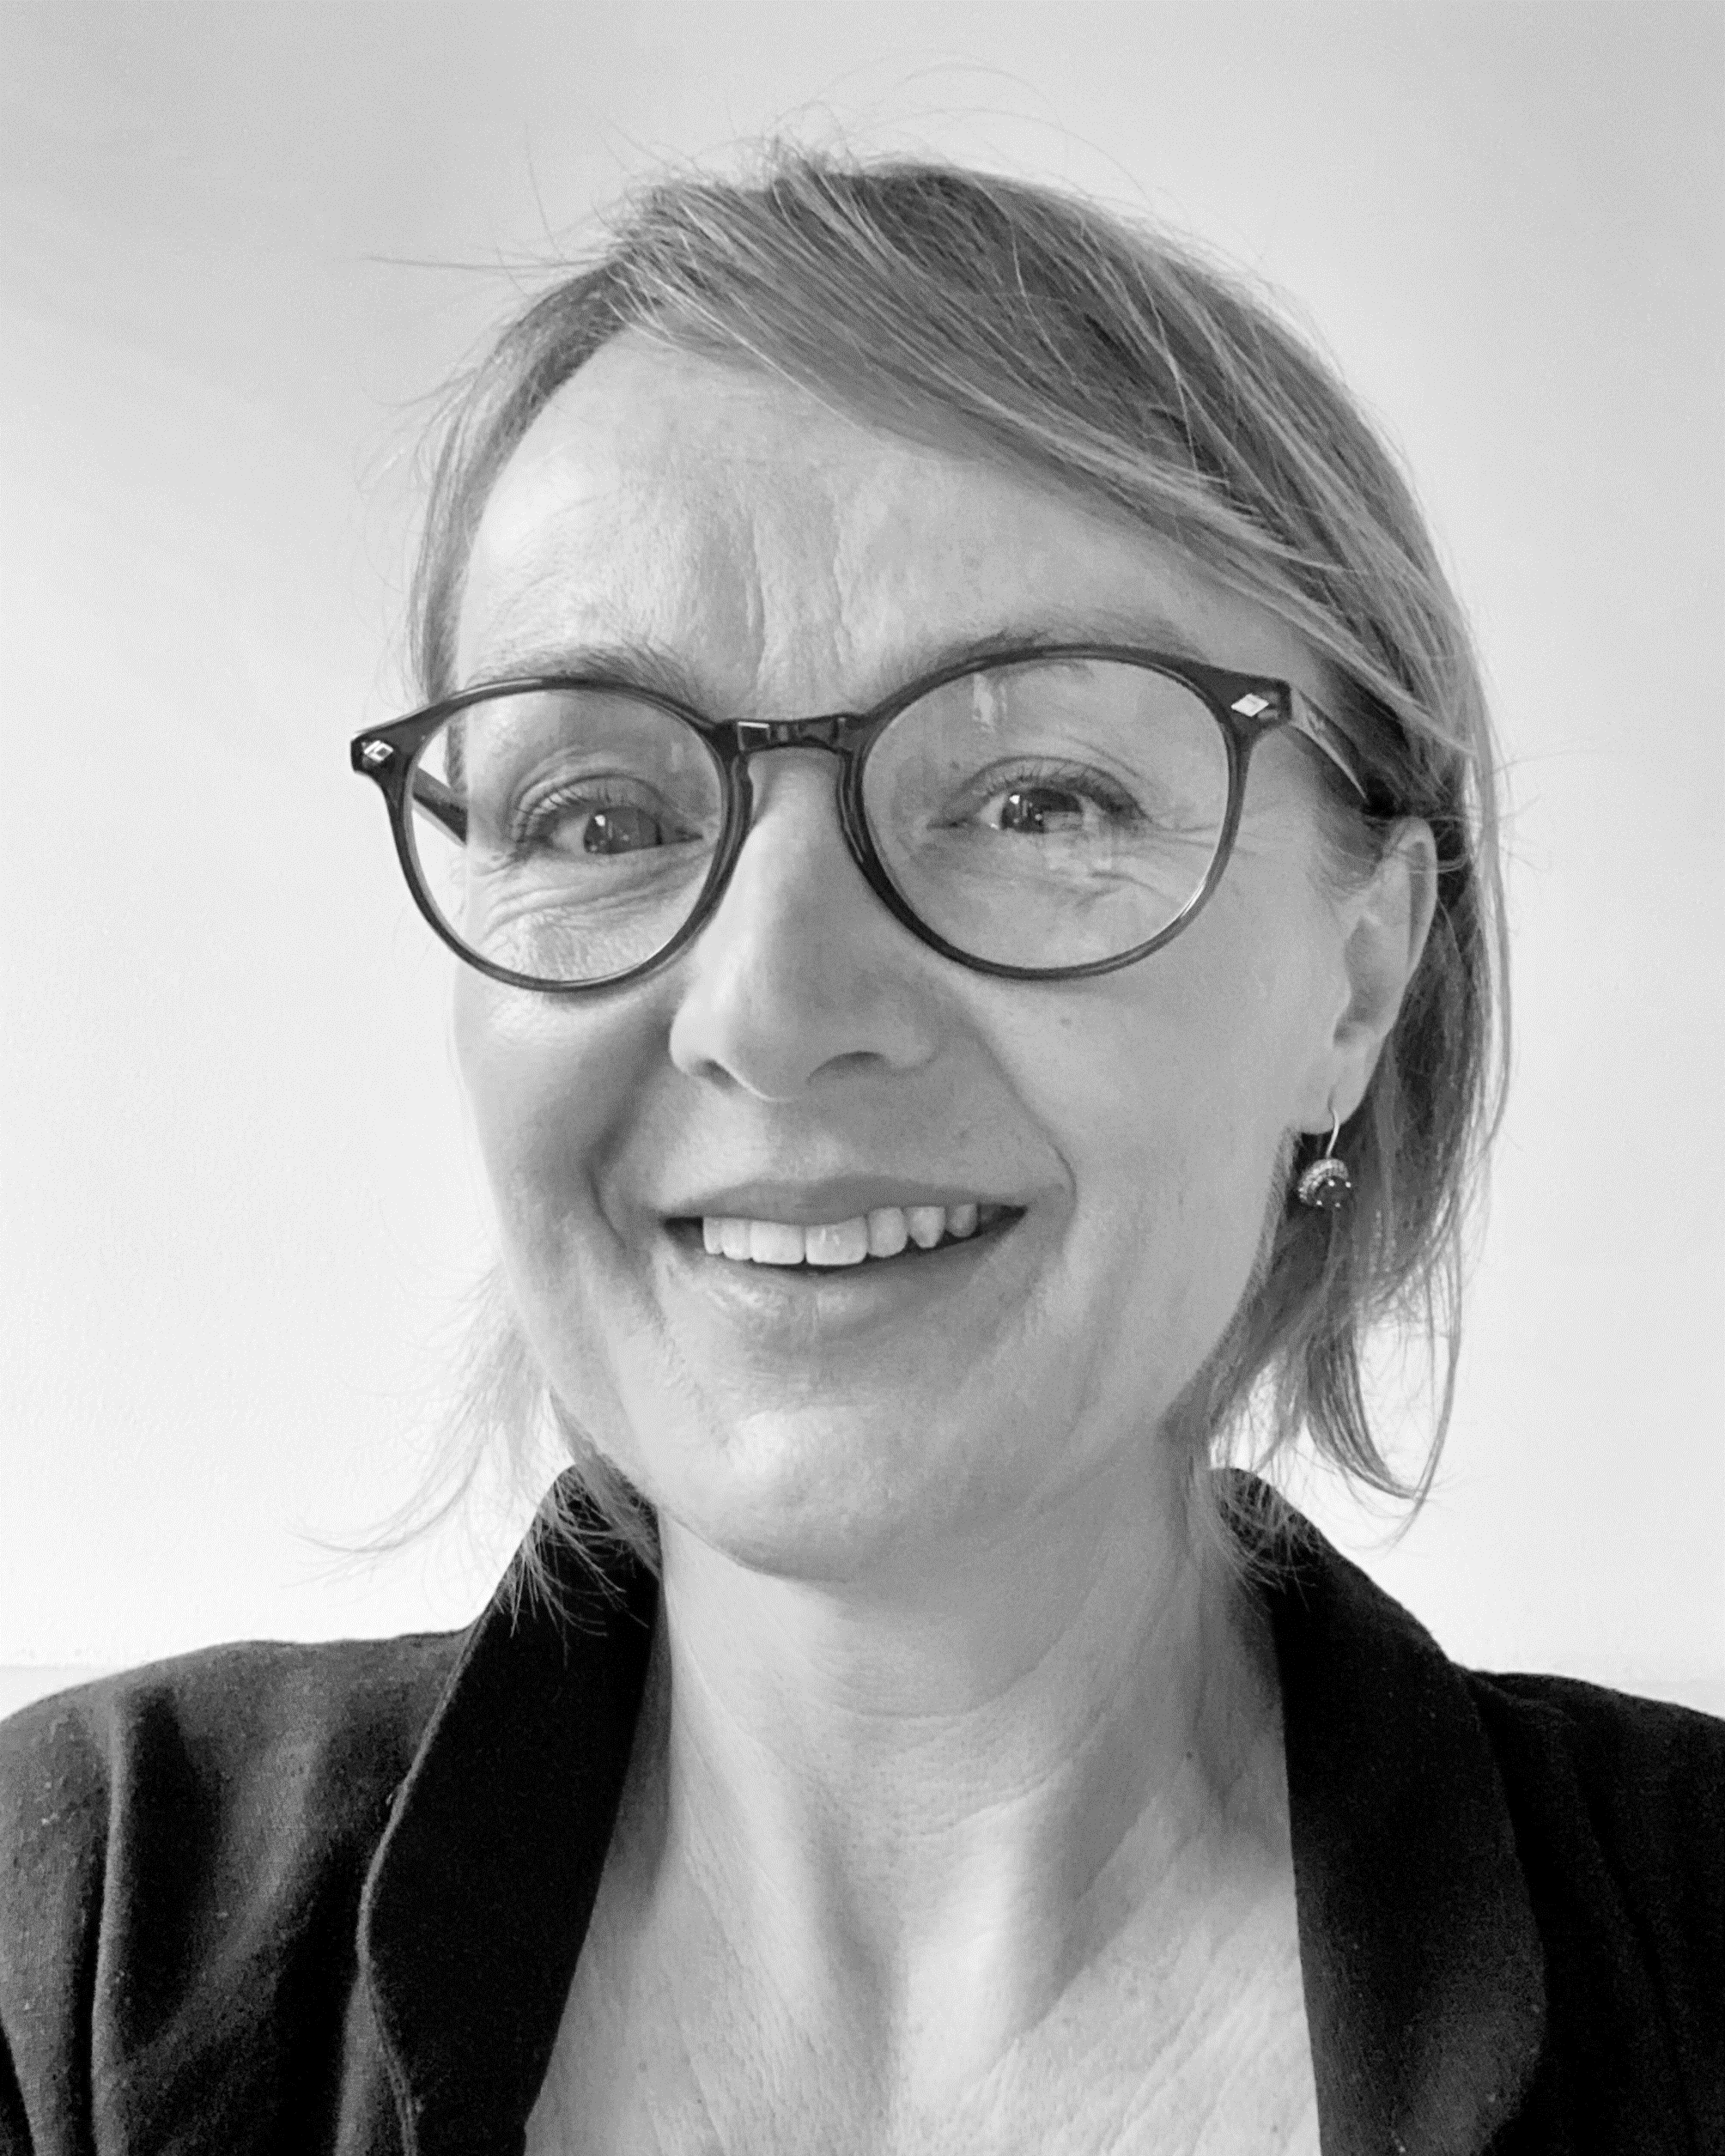
CA21108_WG5_Expert_Series_Webinar
June 16th, 11 AM (CET)
15 min + discussion
Title: Skin barrier lipids
The stratum corneum lipid matrix plays a critical role in preventing water loss and shielding the skin from pathogens and chemical stressors. This first part of the webinar will introduce the fundamental aspects of the composition and structural organization of the skin lipid barrier.
Speaker: Kateřina Vávrová
Charles University, Faculty of Pharmacy, Czech Republic
About the speaker:
Kate Vávrová is a pharmacist with a PhD in bioorganic chemistry, currently a professor at Charles University, Faculty of Pharmacy, Czech Republic, leader of the Skin Barrier Research Group. Her research focuses on skin barrier lipids—particularly ceramides—including their chemical synthesis, analysis in the skin, and biophysical behavior in models of both healthy and impaired skin barriers. Her team also develops strategies for skin barrier restoration and explores drug delivery through the skin. Outside the lab, Kate is a keen skier, biker, and scuba diver, and an observer of nature (including her eight-year-old daughter).

