Slide 1




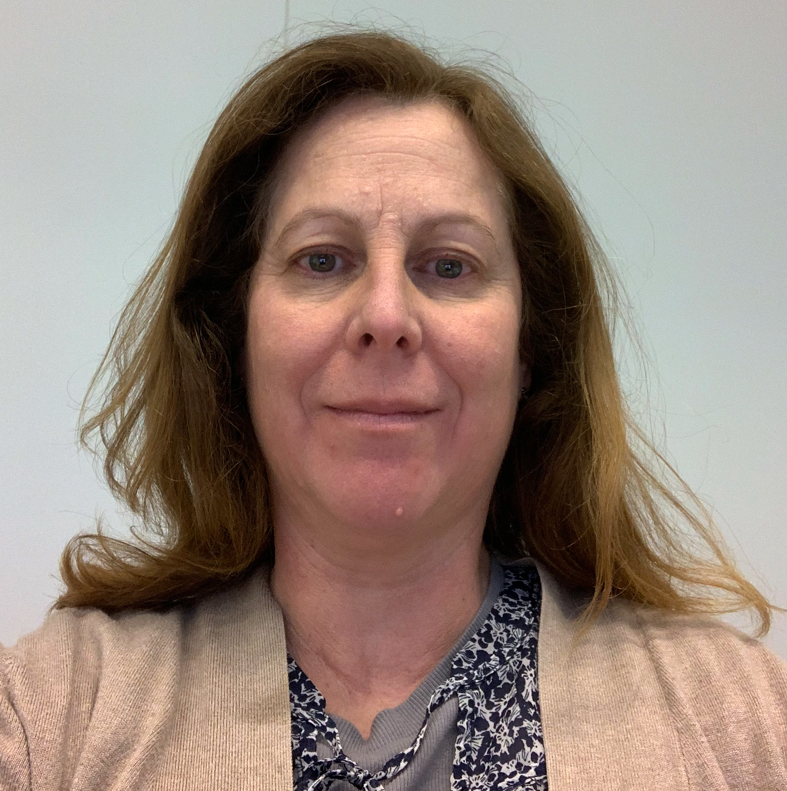
CA21108_WG2_Expert_Series_Webinar
December 9th, 1 PM (CET)
Format (40 min + discussion)
Title:
Generation of Human Induced Pluripotent Stem Cell-derived Planar Hair-bearing Skin Organoids Using an Air-Liquid Interface Culture System
Speaker:
Dr. Karine Raymond
About the speaker:
Dr. Karine Raymond’s research focuses on understanding how specialized skin cells communicate to sense and adapt to environmental challenges such as microbes, UV radiation, and mechanical stress. Her laboratory develops advanced human induced pluripotent stem cell (hiPSC)-based models to study how mutations in rare diseases such as Xeroderma Pigmentosum and Epidermolysis Bullosa disrupt skin homeostasis. The ultimate goal of her research is to develop new therapies and preventive strategies to improve patients’ quality of life.

